Slide 1
Miscellaneous - Selenium
2025
Poornima

Slide 2
File Upload
Using sendKeys() (Recommended)
Locate the file input element (<input type="file">).
Use sendKeys() to pass the absolute path of the file.
WebElement uploadElement = driver.findElement(By.id("file-upload"));
uploadElement.sendKeys("C:\\Users\\YourName\\Documents\\testfile.txt");
driver.findElement(By.id("file-submit")).click();
Works across browsers (Chrome, Firefox, Edge).

Slide 3
SVG Elements
To handle SVG elements in Selenium, you should use XPath locators instead of standard CSS or ID selectors, because SVGs have a unique XML-like structure. Often, you’ll need to combine XPath with functions like local-name() or name() to correctly identify SVG tags, and sometimes use the Actions class for interactions like clicking or hovering
Why SVGs Are Tricky in Selenium
SVGs are XML-based: Unlike HTML, SVG elements don’t always support standard attributes like id or class.
Nested structure: SVGs often contain multiple layers (<svg>, <g>, <path>, etc.), making them harder to locate.
Browser rendering differences: Some browsers treat SVGs differently than HTML, so CSS selectors may fail

Slide 4
SVG Elements
Use XPath with local-name():
SVG tags are in a different namespace, so you can’t just use //svg. Instead:
WebElement svgElement = driver.findElement(
By.xpath("//*[local-name()='svg']//*[local-name()='path']"));
This ensures Selenium recognizes the SVG element.
Target Specific Attributes:
If the SVG element has an attribute (like id, fill, or d), you can use:
WebElement pathElement = driver.findElement(
By.xpath("//*[local-name()='svg']//*[local-name()='path' and @id='myPath']")
);

Slide 5
SVG Elements
Use the Actions Class for Interactions:
Sometimes click() doesn’t work directly on SVGs. Use
Actions actions = new Actions(driver);
actions.moveToElement(pathElement).click().perform();
This simulates a real user interaction
Example: Clicking a Chart Point
WebElement chartPoint = driver.findElement(
By.xpath("//*[local-name()='svg']//*[local-name()='circle' and @class='data-point']")
);
chartPoint.click();

Slide 6
Shadow DOM
Shadow DOM is a web standard that encapsulates part of the DOM tree, isolating styles and elements from the main document.
Elements inside a shadow root are not accessible with normal Selenium locators.
Example: Web components often use Shadow DOM to hide internal structure.
Shadow DOM works by allowing you to attach a hidden, separate Document Object Model (DOM) to an element. This hidden DOM is known as the ‘Shadow DOM’, and the element it’s attached to is referred to as the ‘Shadow Host’.
A Shadow DOM can have additional Shadow Hosts nested under it—this is called a Shadow Tree.

Slide 7
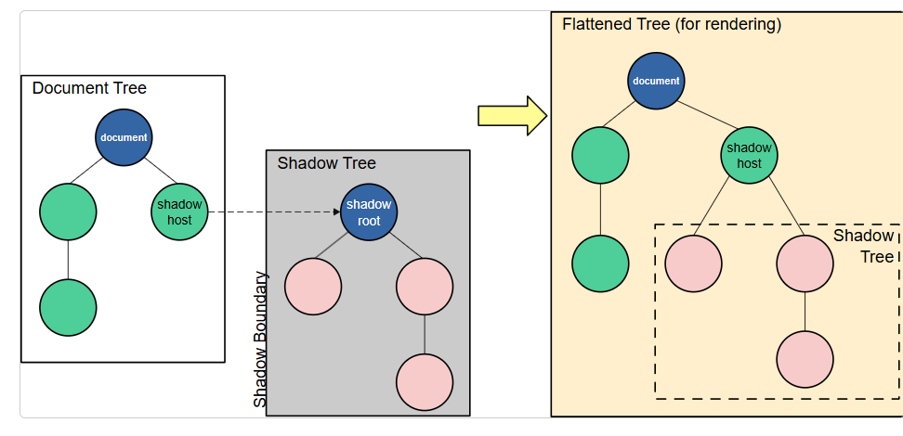
Shadow DOM
Shadow host: The regular DOM node that the shadow DOM is attached to.
Shadow tree: The DOM tree inside the shadow DOM.
Shadow boundary: the place where the shadow DOM ends, and the regular DOM begins.
Shadow root: The root node of the shadow tree.

Slide 8
Shadow DOM
Using Selenium 4’s getShadowRoot()
Selenium 4 added native support for Shadow DOM.
WebElement host = driver.findElement(By.cssSelector("css-selector-of-host"));
SearchContext shadowRoot = host.getShadowRoot();
WebElement shadowElement = shadowRoot.findElement(By.cssSelector("css-selector-inside-shadow"));
shadowElement.click();
XPath cannot handle shadow dom elements.
Only CSS can handle shadow dom elements.
This is the cleanest and recommended approach

Slide 9
Shadow DOM
Handling Nested Shadow DOMs
Some components have multi-level shadow roots. You must recursively traverse:
WebElement level1 = driver.findElement(By.cssSelector("host1"));
SearchContext shadow1 = level1.getShadowRoot();
WebElement level2 = shadow1.findElement(By.cssSelector("host2"));
SearchContext shadow2 = level2.getShadowRoot();
WebElement target = shadow2.findElement(By.cssSelector("final-element"));
target.click();

Slide 10
Broken Links
Detecting broken links in Selenium is a common test automation need, especially for validating website integrity. Selenium itself cannot directly tell if a link is broken, but you can combine it with HTTP requests to check the response codes of all links on a page.
Steps to Handle Broken Links in Selenium
Collect All Links
Use Selenium to find all <a> tags (hyperlinks) or <img> tags (for images).
List<WebElement> links = driver.findElements(By.tagName("a"));
for (WebElement link : links) {
String url = link.getAttribute("href");
System.out.println(url);
}

Slide 11
Broken Links
2. Check HTTP Response
Use Java’s HttpURLConnection to verify each URL.
If the response code is >= 400, the link is broken.
for (WebElement link : links) {
String url = link.getAttribute("href");
try {
HttpURLConnection connection = (HttpURLConnection) new URL(url).openConnection();
connection.setRequestMethod("HEAD");
connection.connect();
int responseCode = connection.getResponseCode();
if (responseCode >= 400) {
System.out.println(url + " is a broken link");
} else {
System.out.println(url + " is valid");
}
} catch (Exception e) {
System.out.println(url + " is invalid: " + e.getMessage());
}
}

Slide 12
Broken Links
Step | Action
1 | Collect all links with Selenium
2 | Send HTTP request to each link
3 | Mark links with status ≥ 400 as broken
4 | Log/report broken links

Slide 13
Chrome Options
ChromeOptions lets you customize and control Google Chrome’s behavior when launching it via Selenium. It’s a driver-specific options class built on top of ChromiumOptions, supporting arguments, preferences, extensions, custom binaries, mobile emulation, and use with local ChromeDriver or RemoteWebDriver/Grid
What ChromeOptions does
Browser customization: Add command-line arguments (flags) like headless, incognito, or disabling GPU to tune behavior for tests and CI.
Preferences and profiles: Configure Chrome preferences (e.g., default download directory, popup behavior), or use a specific user data directory to mimic a profile.
Extensions and custom binary: Load .crx extensions or point Selenium to a non-default Chrome binary (portable or Canary).
Remote usage: Pass ChromeOptions to RemoteWebDriver to run against Selenium Grid or cloud providers.
Mobile emulation: Emulate mobile devices and Android Chrome via the options API in Python; similar capabilities exist on the ChromiumOptions layer in Java

Slide 14
Chrome Options
Core APIs and common use cases
import org.openqa.selenium.WebDriver;
import org.openqa.selenium.chrome.ChromeDriver;
import org.openqa.selenium.chrome.ChromeOptions;
ChromeOptions options = new ChromeOptions();
// Arguments (flags)
options.addArguments("--headless=new", "--disable-gpu", "--window-size=1920,1080", "--incognito");
// Preferences
java.util.HashMap<String, Object> prefs = new java.util.HashMap<>();
prefs.put("download.default_directory", "C:\\Downloads");
prefs.put("profile.default_content_settings.popups", 0);
options.setExperimentalOption("prefs", prefs);
// Extensions
// options.addExtensions(new java.io.File("path/to/extension.crx"));
WebDriver driver = new ChromeDriver(options);

Slide 15
Chrome Options
addArguments: Supply Chrome flags to adjust runtime behavior
setExperimentalOption("prefs", …): Pass Chrome preferences for downloads, popups, notifications, etc.
addExtensions: Load extension files for scenarios requiring add-ons
Headless Browser Testing generally means an object/ thing with no head, and in context to browsers, it means browser simulation, which has no UI.
Headless browser automation uses a web browser for end-to-end testing without loading the browser’s UI.
ChromeOptions options = new ChromeOptions();
options.addArguments("--headless=new");
Chrome, Firefox, and Edge headless browsers

